Slide 1
Intro to the Rust Programming Language
Ian Lumsden

Slide 2
Contents: Session 1
What is Rust, and why should you use it?
Language Rules

Slide 3
Contents: Session 2
“Object Oriented” Rust
Enums

Slide 4
Contents: Session 3
Modules and Rust Editions
Intro to Some Important Advanced Features

Slide 5

What is Rust?
New multi-paradigm systems programming language.
Started in 2006 (first release in 2010) by researchers from Mozilla (not Mozilla itself).

Slide 6
What is Rust?
“Most loved programming language” in Stack Overflow’s Developer Survey every year since 2016.

Slide 7
What is Rust?
“Most loved programming language” in Stack Overflow’s Developer Survey every year since 2016.
Designed for “frustrated C++ developers”

Slide 8
What is Rust?
“Most loved programming language” in Stack Overflow’s Developer Survey every year since 2016.
Designed for “frustrated C++ developers”
Designed to be as efficient and performant as C++, but without many of the dangers of unsafe C and C++ code.

Slide 9
Installing Rust
Rust provides the rustup tool to manage the installation and updating of Rust’s three main components:
rustc, the Rust compiler
The Rust standard library
cargo, the Rust build system/package manager.

Slide 10
Installing Rust
Unix
Run the following and follow the on-screen instructions:
https://sh.rustup.rs -sSf | sh
Windows
Go to https://www.rust-lang.org/tools/install
Download and run the installer for Rustup, the Rust updater.

Slide 11
Installing evcxr
This tutorial uses Jupyter.

Slide 12
Installing evcxr
This tutorial uses Jupyter.
To use Rust in Jupyter, you need evcxr, a Rust Jupyter kernel made by Google.

Slide 13
Installing evcxr
If you don’t already have it, install Jupyter through conda or pip.
Run cargo install evxcr_jupyter.
Run evcxr_jupyter –install.

Slide 14
Why Rust?
Summarized by Rust’s “mission statement”

Slide 15
Why Rust?
Summarized by Rust’s “mission statement”
“Rust is a systems programming language focused on three goals: safety, speed, and concurrency.”

Slide 16
Why Rust?
Speed

Slide 17
Why Rust?
Speed
Fully compiled language without runtime.

Slide 18
Why Rust?
Speed
Fully compiled language without runtime.
Rust compiler is built on top of LLVM.

Slide 19
Why Rust?
Speed
Fully compiled language without runtime.
Rust compiler is built on top of LLVM.
Same as Clang.

Slide 20
Why Rust?
Speed
Fully compiled language without runtime.
Rust compiler is built on top of LLVM.
Same as Clang.
Rust code is similar in performance to Clang-compiled C/C++ code.

Slide 21
Why Rust?
Speed
https://benchmarksgame-team.pages.debian.net/benchmarksgame/fastest/rust.html

Slide 22
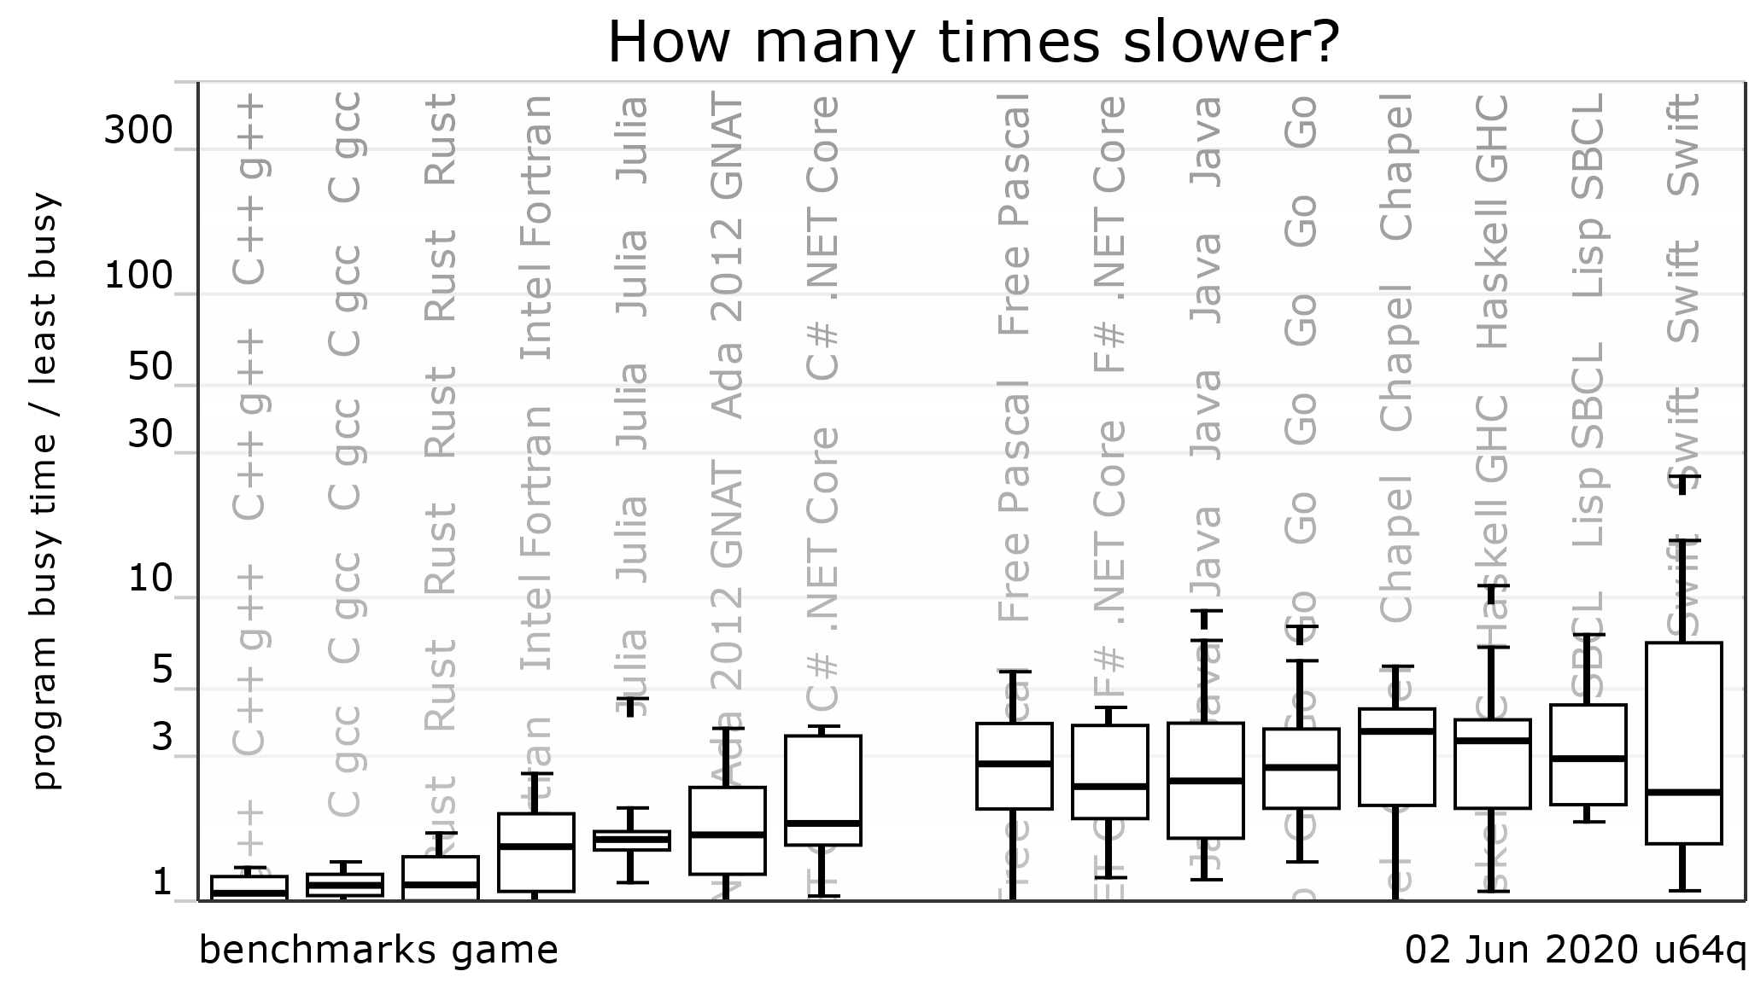
Why Rust?
Speed
https://benchmarksgame-team.pages.debian.net/benchmarksgame/fastest/rust.html

Slide 23
Why Rust?
Development Speed
Rust’s compiler and language rules do more for the developer than C/C++.
It is often faster to write working, bug-free code in Rust than in C/C++ so long as you are implementing all the same features.

Slide 24
Why Rust?
Concurrency
Mostly comes from Rust’s safety guarantees.

Slide 25
Why Rust?
Concurrency
Improves on C/C++ concurrency safety features (mutexes) by directly tying safety mechanisms and data together.

Slide 26
Why Rust?
Concurrency
More expressive and powerful than (non-third-party) C/C++ equivalents.
C/C++: POSIX threads, mutexes, etc.
Rust: Interthread message passing

Slide 27
Why Rust?
Safety

Slide 28
Why Rust?
Safety
NO SEG FAULTS!!!!!

Slide 29
Why Rust?
Safety
There are several sets of rules built into the Rust language that prevent memory related bugs/crashes that are common in C/C++ code.

Slide 30
Rust’s Rules
Ownership Rules
Mutability Rules
Data Lifetime Rules

Slide 31
Ownership Rules
Three ownership rules:

Slide 32
Ownership Rules
Three ownership rules:
“Each value in Rust has a variable that’s called its owner.”

Slide 33
Ownership Rules
Three ownership rules:
“Each value in Rust has a variable that’s called its owner.”
“There can only be one owner at a time.”

Slide 34
Ownership Rules
Three ownership rules:
“Each value in Rust has a variable that’s called its owner.”
“There can only be one owner at a time.”
“When the owner goes out of scope, the value will be dropped.”

Slide 35
Ownership Rules
function main() {
String s1 = “hello”;
String s2 = s1;
println(s1);
println(s2);
}

Slide 36
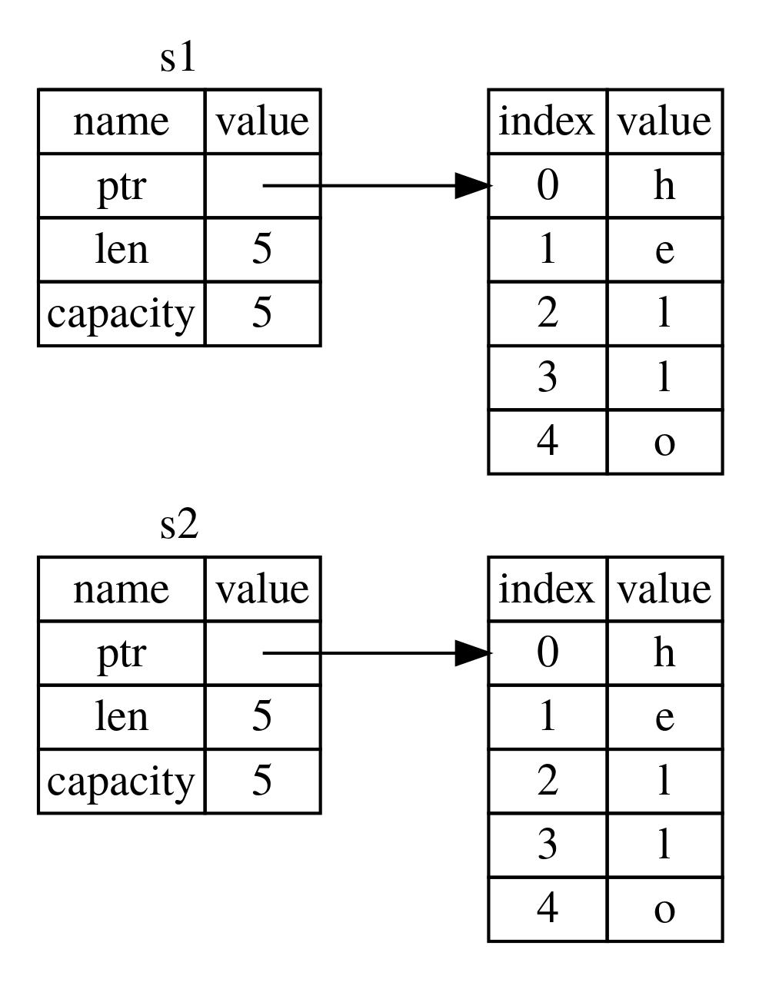
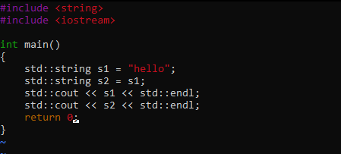
Ownership Rules

Slide 37
Ownership Rules

Slide 38
Ownership Rules

Slide 39
Ownership Rules
Three ownership rules:
“Each value in Rust has a variable that’s called its owner.”
“There can only be one owner at a time.”
“When the owner goes out of scope, the value will be dropped.”

Slide 40
Ownership Rules
Three ownership rules:
“Each value in Rust has a variable that’s called its owner.”
“There can only be one owner at a time.”
“When the owner goes out of scope, the value will be dropped.”

Slide 41
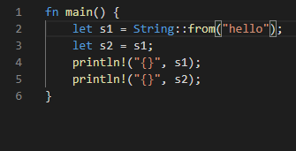
Ownership Rules

Slide 42
Ownership Rules

Slide 43
Ownership Rules

Slide 44
Ownership Rules
Three ownership rules:
“Each value in Rust has a variable that’s called its owner.”
“There can only be one owner at a time.”
“When the owner goes out of scope, the value will be dropped.”

Slide 45
Ownership Rules
Why are ownership rules important/useful?

Slide 46
Ownership Rules
Why are ownership rules important/useful?
Allows Rust to be completely memory safe without the use of a Garbage Collector (GC).
Ownership is essentially a compile-time GC.

Slide 47
Ownership Rules
Why are ownership rules important/useful?
How can I pass data between functions without violating the ownership rules?

Slide 48
Ownership Rules: Borrowing
Similar to C++ references.
Specified using “&” before the type.

Slide 49
Ownership Rules: Borrowing
A Rust reference borrows the underlying data. It does not own the underlying data.

Slide 50
Ownership Rules: Borrowing
A Rust reference borrows the underlying data. It does not own the underlying data.
This is the same as a C++ reference.

Slide 51
Ownership Rules: Borrowing
A Rust reference borrows the underlying data. It does not own the underlying data.
This is the same as a C++ reference.
Pointers vs Borrows

Slide 52
Ownership Rules: Borrowing
Pointer
Borrow
Implemented as raw pointer.
Cannot safely dereference.
Misuse can rarely be caught by the compiler.
Implemented as raw pointer.
Can safely dereference (use * operator).
Misuse almost always causes compilation errors.

Slide 53
Ownership Rules: Borrowing
Borrows are essentially Rust’s version of C/C++ pointers.

Slide 54
Ownership Rules: Borrowing
Borrows are essentially Rust’s version of C/C++ pointers.
Raw pointers (similar to C/C++) are provided only for compatibility with C/C++ code.

Slide 55
Ownership Rules: Borrowing
Borrows are essentially Rust’s version of C/C++ pointers.
Raw pointers (similar to C/C++) are provided only for compatibility with C/C++ code.
Ownership and Lifetime rules allow borrows to be managed by compiler.

Slide 56
Slicing
A special form of borrowing that can be applied to containers (e.g. arrays).

Slide 57
Slicing
A special form of borrowing that can be applied to containers (e.g. arrays).
Allows the programmer to store a reference to a subsection of a container.

Slide 58
Slicing
A special form of borrowing that can be applied to containers (e.g. arrays).
Allows the programmer to store a reference to a subsection of a container.
Practically the same as Python slicing.

Slide 59
Slicing
Syntax: &var[start..end]
If start is excluded, the slice will start from the beginning of the container.
If end is excluded, the slice will end with the last element of the container.
If both are excluded, the slice will be a reference to the entire container.
Usually the same as &var

Slide 60
String Slices
Rust Strings are containers of Unicode characters.

Slide 61
String Slices
Rust Strings are containers of Unicode characters.
This differs from C/C++, where strings are encoding-agnostic.

Slide 62
String Slices
Rust Strings are containers of Unicode characters.
This differs from C/C++, where strings are encoding-agnostic.
Since a string is a container, it can be sliced.

Slide 63
String Slices
Unlike other slices, String slices have their own special type: &str.

Slide 64
String Slices
Unlike other slices, String slices have their own special type: &str.
This is the type of a string literal.

Slide 65
String Slices
Unlike other slices, String slices have their own special type: &str.
This is the type of a string literal.
This is not necessarily the same as &String (reference to std::String).

Slide 66
String Slices
Passing string slice to function:
If parameter type is &str, either &String or &str can be passed.
If parameter type is &String, only &String can be passed.

Slide 67
String Slices
Unlike other slices, String slices have their own special type: &str.
This is the type of a string literal.
This is not necessarily the same as &String (reference to std::String).
When slicing a std::String, use the reference operator (&) to get &String, and use slicing (&var[]) to get &str.

Slide 68
String Slices: Character Iteration
Rust Strings are encoded with Unicode.

Slide 69
String Slices: Character Iteration
Rust Strings are encoded with Unicode.
For legacy support with C/C++, indexing and slicing using [] operates on the bytes of the string, not the characters.

Slide 70
String Slices: Character Iteration
Rust Strings are encoded with Unicode.
For legacy support with C/C++, indexing and slicing using [] operates on the bytes of the string, not the characters.
To iterate over the characters, use the String.chars function to get an iterator.

Slide 71
Mutability Rules
In C/C++, variables can have one of two mutability type modifiers:

Slide 72
Mutability Rules
In C/C++, variables can have one of two mutability type modifiers:
Const (immutable)

Slide 73
Mutability Rules
In C/C++, variables can have one of two mutability type modifiers:
Const (immutable)
Non-const (mutable)

Slide 74
Mutability Rules
In Rust, variables can have one of three mutability type modifiers:

Slide 75
Mutability Rules
In Rust, variables can have one of three mutability type modifiers:
Const

Slide 76
Mutability Rules
In Rust, variables can have one of three mutability type modifiers:
Const
Immutable

Slide 77
Mutability Rules
In Rust, variables can have one of three mutability type modifiers:
Const
Immutable
Mutable

Slide 78
Mutability Rules
Const
Constant values defined at compile time

Slide 79
Mutability Rules
Const
Constant values defined at compile time
Because they’re defined at compile time, Rust constants cannot be passed to functions (see Rust RFC 2000 for implementation details).

Slide 80
Mutability Rules
Const
Constant values defined at compile time
Because they’re defined at compile time, Rust constants cannot be passed to functions (see Rust RFC 2000 for implementation details).
Similar to C/C++ Macro variables (e.g. #define MYVAL 5).

Slide 81
Mutability Rules
Immutable
Constant values defined at runtime.

Slide 82
Mutability Rules
Immutable
Constant values defined at runtime.
Because they’re defined at runtime, immutable variables can be passed to functions.

Slide 83
Mutability Rules
Immutable
Constant values defined at runtime.
Because they’re defined at runtime, immutable variables can be passed to functions.
Similar to C/C++ const variables.

Slide 84
Mutability Rules
Mutable
Non-constant value defined at runtime.
Same as unmodified C/C++ variable.

Slide 85
Mutability Rules
By default, Rust variables are immutable.

Slide 86
Mutability Rules
By default, Rust variables are immutable.
To make a variable mutable, use the mut keyword.

Slide 87
Mutability Rules
Immutable vs const variables

Slide 88
Mutability Rules
Immutable vs const variables
Runtime vs Compile time definition

Slide 89
Mutability Rules
Immutable vs const variables
Runtime vs Compile time definition
Shadowing

Slide 90
Mutability Rules
Immutable vs const variables
Runtime vs Compile time definition
Shadowing
Allows immutable variables to be overwritten using the let keyword.

Slide 91
Mutability Rules: Shadowing
{
let x = String::from(“Hello”);
// Do something with x
let x = 20;
}

Slide 92
Mutability Rules: Shadowing
Stack
{
let x = String::from(“Hello”);
// Do something with x
let x = 20;
}

Slide 93
Mutability Rules: Shadowing
Stack
{
let x = String::from(“Hello”);
// Do something with x
let x = 20;
}
String “Hello”

Slide 94
Mutability Rules: Shadowing
Stack
{
let x = String::from(“Hello”);
// Do something with x
let x = 20;
}
x
String “Hello”

Slide 95
Mutability Rules: Shadowing
Stack
{
let x = String::from(“Hello”);
// Do something with x
let x = 20;
}
x
String “Hello”
…

Slide 96
Mutability Rules: Shadowing
Stack
{
let x = String::from(“Hello”);
// Do something with x
let x = 20;
}
x
String “Hello”
…
20

Slide 97
Mutability Rules: Shadowing
Stack
{
let x = String::from(“Hello”);
// Do something with x
let x = 20;
}
x
String “Hello”
…
20

Slide 98
Mutability Rules: Shadowing
Stack
{
let x = String::from(“Hello”);
// Do something with x
let x = 20;
}
…

Slide 99
Mutability Rules: Shadowing
Made possible by ownership rule #3:
“When the owner goes out of scope, the value will be dropped.”

Slide 100
Mutability Rules: Shadowing
Made possible by ownership rule #3:
“When the owner goes out of scope, the value will be dropped.”
Shadowed values are still owned by their original variable.

Slide 101
Mutability Rules
Immutable vs const variables
Runtime vs Compile time definition
Shadowing
Immutable variables can be shadowed.
Const variables cannot.

Slide 102
Mutability Rules
Why are variables immutable by default?

Slide 103
Mutability Rules
Why are variables immutable by default?
Most variables don’t need to be mutable!

Slide 104
Mutability Rules
Why are variables immutable by default?
Most variables don’t need to be mutable!
In fact, the C and C++ communities/committees encourage coders to make variables const except when mutability is required.

Slide 105
Mutability Rules
Why are variables immutable by default?
Provides protection in concurrent code.

Slide 106
Mutability Rules
Why are variables immutable by default?
Provides protection in concurrent code.
Mutual exclusion is guaranteed on immutable variables.

Slide 107
Mutability Rules
Why are variables immutable by default?
Provides protection in concurrent code.
Mutual exclusion is guaranteed on immutable variables.
Improves performance of concurrent code.

Slide 108
Mutability Rules
Why are variables immutable by default?
Provides protection in concurrent code.
Mutual exclusion is guaranteed on immutable variables.
Improves performance of concurrent code.
More Immutable Variables -> More Guaranteed Mutual Exclusion -> Less Mutexes

Slide 109
Mutability Rules: Borrowing
There are two rules regarding borrowing and mutability.

Slide 110
Mutability Rules: Borrowing
There are two rules regarding borrowing and mutability.
At any given time, you can have either one mutable reference or any number of immutable references.

Slide 111
Mutability Rules: Borrowing
There are two rules regarding borrowing and mutability.
At any given time, you can have either one mutable reference or any number of immutable references.
References must always be valid.

Slide 112
Lifetimes
Like scoping in other languages.
Defines how long a reference is valid.
How the compiler knows you’re obeying the borrowing rules.

Slide 113
Lifetimes
Like scoping in other languages.
Defines how long a reference is valid.
How the compiler knows you’re obeying the borrowing rules.
If a reference’s lifetime is greater than the data it’s referring to, the compiler will yell at you.
https://theta.eu.org/2016/04/16/lyar-lifetimes.html

Slide 114
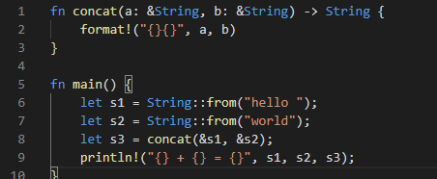
Lifetimes

Slide 115
Lifetimes
Static Lifetime
Owner Scope (i.e. Lifetime)
Reference Lifetime
Reference User Lifetime
https://theta.eu.org/2016/04/16/lyar-lifetimes.html

Slide 116
Lifetimes
Usually, the compiler can infer lifetimes and handle everything for you.

Slide 117
Lifetimes
Usually, the compiler can infer lifetimes and handle everything for you.
However, sometimes it can’t!

Slide 118
Lifetimes: Annotations
In cases where the compiler cannot guarantee lifetime rules, the programmer must tell the compiler the scope of the object/function/struct/etc.

Slide 119
Lifetimes: Annotation
To tell the compiler what the lifetimes of references should be, use annotations.
Specified by placing <‘lifetime_identifier> after the name of the struct/function/etc. being annotated.

Slide 120
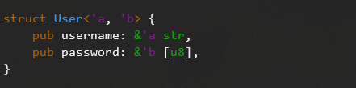
Lifetimes: Struct Annotation
Whenever a struct’s field is a reference, you must add annotations.

Slide 121
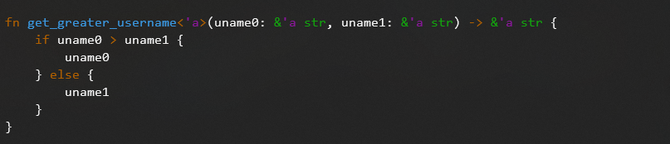
Lifetimes: Function Annotation

Slide 122
Intro to the Rust Programming Language: Session 2
Ian Lumsden

Slide 123
Contents: Session 1
What is Rust, and why should you use it?
Language Rules

Slide 124
Contents: Session 2
“Object Oriented” Rust
Enums

Slide 125
“Object Oriented” Rust
Rust is not an object-oriented language.

Slide 126
“Object Oriented” Rust
Rust is not an object-oriented language.
Closer to C than C++, Java, etc.

Slide 127
“Object Oriented” Rust
Rust is not an object-oriented language.
Provides Object-Oriented-like behavior through three features:

Slide 128
“Object Oriented” Rust
Rust is not an object-oriented language.
Provides Object-Oriented-like behavior through three features:
Structs
Impl Blocks
Traits

Slide 129
“Object Oriented” Rust: Structs
Similar to C’s structs.
Specified using the struct keyword.
Defines a new datatype, its fields, and the fields’ types.

Slide 130
“Object Oriented” Rust: Impl
Defines the functionality/methods of a struct.
Specified using impl StructName.
In this block, there are two special keywords:
self: alias to the current StructName object.
Self: refers to the type of the impl block.

Slide 131
“Object Oriented” Rust: Traits
Similar to interfaces in object-oriented languages like C++ and Java.
Defines a required functionality for an abstract data type.
Specified using trait keyword.
Similar to impl block, but only contains function signatures.

Slide 132
“Object Oriented” Rust: Traits
For a struct to “inherit” a trait, it must implement that trait.

Slide 133
“Object Oriented” Rust: Traits
For a struct to “inherit” a trait, it must implement that trait.
Done using a special impl block that starts with impl TraitName for StructName.
Functions in block should provide implementations for trait functions.

Slide 134
“Object Oriented” Rust
Structs and impl blocks provide functionality similar to C++ classes.
Traits provide functionality similar to inheritance.

Slide 135
Enums
Similar, but much more powerful than C/C++ enums.

Slide 136
Enums
Similar, but much more powerful than C/C++ enums.
Specifies a variant type.

Slide 137
Enums
Similar, but much more powerful than C/C++ enums.
Specifies a variant type.
Powerful variant matching with match and if let statements.

Slide 138
Enums: Match Statements
Similar to C/C++ switch statements.
Allows you to “match“ variants of an enum and run code specific to each variant.
Allows you to unpack data from each variant.

Slide 139
Enums: Match Statements
Similar to C/C++ switch statements.
Allows you to “match“ variants of an enum and run code specific to each variant.
Allows you to unpack data from each variant.
Must have rule for every variant!

Slide 140
Enums: If Let Statements
Provide the same functionality as match statements, but lets you consider just one variant.

Slide 141
Enums
C/C++ Enums
Rust Enums
Represented as integer.
Variants are all differently valued integers.
Enums are not types.
Basic value matching through conditionals.
Represented by any type.
Variants can contain different data.
Enums are types.
Powerful variant matching and data extraction through match and if let.

Slide 142
Special Enums
There are two special enums built into the language to provide special functionality.

Slide 143
Special Enums
There are two special enums built into the language to provide special functionality.
Option
Result

Slide 144
Special Enums: Option
Rust does not have any concept of NULL.

Slide 145
Special Enums: Option
Rust does not have any concept of NULL.
In its place, Rust provides the Option enum.

Slide 146
Special Enums: Option
Rust does not have any concept of NULL.
In its place, Rust provides the Option enum.
Used to represent optional values.

Slide 147
Special Enums: Option
Two variants:
Some(val): represents that some value is stored.
None: represents a lack of value.

Slide 148
Special Enums: Result
Unlike many modern programming languages, Rust does not have a C++-style exception handling system.

Slide 149
Special Enums: Result
Unlike many modern programming languages, Rust does not have a C++-style exception handling system.
Instead, it uses a C-style error-return system .

Slide 150
Special Enums: Result
Unlike many modern programming languages, Rust does not have a C++-style exception handling system.
Instead, it uses a C-style error-return system.
Instead of using integers to indicate success and errors, Rust uses the Result enum.

Slide 151
Special Enums: Result
Instead, it uses a C-style error-return system for recoverable errors, …
Instead of using integers to indicate success and errors, Rust uses the Result enum.

Slide 152
Special Enums: Result
Instead, it uses a C-style error-return system for recoverable errors, …
Instead of using integers to indicate success and errors, Rust uses the Result enum.
And the panic! macro for unrecoverable errors.

Slide 153
Special Enums: Result
Two Variants:
Ok(val): represents a successful return.
Err(err_val): represents an error (indicated by the stored values).

Slide 154
Special Enums
You can handle either of these special enums using match and if let.

Slide 155
Special Enums
You can handle either of these special enums using match and if let.
Handling Option and Result are extremely common operations.

Slide 156
Special Enums
You can handle either of these special enums using match and if let.
Handling Option and Result are extremely common operations.
Rust provides several methods for these enums to automate this matching.

Slide 157
Special Enums: Methods
unwrap: returns contained value if variant is positive (Some, Ok) or panics if variant is negative.
expect: same as unwrap, but allows the user to set a custom message on failure.

Slide 158
Special Enums: Methods
? Operator (2018 edition only): returns the stored value if variant is positive. Otherwise, returns the negative variant from the current function.

Slide 159
Module System
Unlike many systems languages, Rust has a built-in module system.

Slide 160
Module System
Unlike many systems languages, Rust has a built-in module system.
Similar to Python’s module system.

Slide 161
Module System
Unlike many systems languages, Rust has a built-in module system.
Similar to Python’s module system.
Syntax and file layout depends on the Rust edition you’re using.

Slide 162
Rust Editions
How is Rust released?

Slide 163
Rust Editions
How is Rust released?
Rust has three release channels:
Nightly
Beta
Stable

Slide 164
Rust Editions
How is Rust released?
Rust has three release channels:
Nightly: Releases every night
Beta: Releases every 6 weeks
Stable: Releases every 6 weeks (one period behind Beta)

Slide 165
Rust Editions
Why does release cycle matter?

Slide 166
Rust Editions
Why does release cycle matter?
Short Release Cycle => Fewer new features per release

Slide 167
Rust Editions
Why does release cycle matter?
Short Release Cycle => Fewer new features per release
Eventually, changes add up, but it might be hard for programmers to keep track of changes.

Slide 168
Rust Editions
Rust editions combine all the features from prior releases along with several new API/ABI changing features into a single large package.

Slide 169
Rust Editions
Rust editions combine all the features from prior releases along with several new API/ABI changing features into a single large package.
Similar to C++ Standards.

Slide 170
Rust Editions: Compatibility
Like C++ standards, Rust editions may add backwards incompatible changes (like adding new keywords).

Slide 171
Rust Editions: Compatibility
Like C++ standards, Rust editions may add backwards incompatible changes (like adding new keywords).
However, unlike C++, two pieces of Rust code that are built with different editions can still be linked together.

Slide 172
Rust Editions
To summarize:
Rust editions combine all new features since last edition plus new API changes.
Rust code compiled with different editions can be linked together after being compiled.

Slide 173
Rust Editions
To summarize:
Rust editions combine all new features since last edition plus new API changes.
Rust code compiled with different editions can be linked together after being compiled.
Unlike C++, past Rust editions are still maintained with new releases.

Slide 174
Rust Editions
Currently, there are two existing Rust editions and one planned:
Rust 2015 (existing)
Rust 2018 (existing)
Rust 2021 (planned)

Slide 175
Rust Editions: Rust 2015
The original, default edition.
Released alongside Rust v1.0
Focus on “stability”.

Slide 176
Rust Editions: Rust 2018
The current newest edition.
Released alongside Rust 1.31
Focus on “productivity”
Newer, simpler syntax designed to make Rust code easier to write.
Smarter borrow-checker.

Slide 177
Module System
Rust 2018 made significant changes to Rust’s module system.

Slide 178
Module System
Rust 2018 made significant changes to Rust’s module system.
Improved import syntax.
First-class module system support for macros.
(Arguably) better file organization.

Slide 179
Module System
What is a module?
Single, named collection of Rust code with a distinct “include” path.

Slide 180
Module System
What is a module?
Three ways to define a module:

Slide 181
Module System
What is a module?
Three ways to define a module:
Region of code (surrounded by curly braces) marked with the mod keyword.

Slide 182
Module System
What is a module?
Three ways to define a module:
Region of code (surrounded by curly braces) marked with the mod keyword.
A “.rs” file.

Slide 183
Module System
What is a module?
Three ways to define a module:
Region of code (surrounded by curly braces) marked with the mod keyword.
A “.rs” file.
A subdirectory of the “src” directory.

Slide 184
Module System: Example
Module Hierarchy
hello
world
foo
bar

Slide 185
Module System: 2015 Example
Module Hierarchy
File System Layout
hello
src/
lib.rs or main.rs
world
foo
world.rs
foo/
bar
mod.rs
bar.rs

Slide 186
Module System: 2018 Example
Module Hierarchy
File System Layout
hello
src/
lib.rs or main.rs
world
foo
world.rs
bar.rs
bar
foo/
mod.rs

Slide 187
Module System: Compatibility
Rust 2015 and 2018 are fully compatible.

Slide 188
Module System: Compatibility
Rust 2015 and 2018 are fully compatible.
Rust 2018 code can use Rust 2015 code (or vice versa).

Slide 189
Module System: Compatibility
Rust 2015 and 2018 are fully compatible.
Rust 2018 code can use Rust 2015 code (or vice versa).
Rust 2018 can use Rust 2015’s module layout system.

Slide 190
Module System: Importing and Exporting
For the most part, importing and exporting is the same across all editions of Rust.

Slide 191
Module System: Importing and Exporting
For the most part, importing and exporting is the same across all editions of Rust.
However, Rust 2018 does have a few differences.

Slide 192
Module System: Importing and Exporting
For the most part, importing and exporting is the same across all editions of Rust.
However, Rust 2018 does have a few differences.
Since Rust 2018 is the primary edition today, the rest of this tutorial will focus on this edition.
Rust 2018 edition-specific features/syntax will be indicated with red text.

Slide 193
Module System: Importing and Exporting
Exporting:
By default, all components of a module are private (not exported).

Slide 194
Module System: Importing and Exporting
Exporting:
By default, all components of a module are private (not exported).
To export a module component, add the pub material to the beginning of the definition.
For example, pub struct MyType

Slide 195
Module System: Importing and Exporting
Exporting
Privacy Rules:
If an item is public, you can access that item from any module that can also access all the item’s parent modules.
If an item is private, you can access that item from its module and that module’s descendants.

Slide 196
Module System: Importing and Exporting
Module Hierarchy
hello
world
foo
bar

Slide 197
Module System: Importing and Exporting
Module Hierarchy
hello
world
foo
bar

Slide 198
Module System: Importing and Exporting
Module Hierarchy
hello
world
foo
bar

Slide 199
Module System: Importing and Exporting
Module Hierarchy
hello
world
foo
bar

Slide 200
Module System: Importing and Exporting
Module Hierarchy
hello
world
foo
bar

Slide 201
Module System: Importing and Exporting
Targeted Exporting:
4 syntax options:

Slide 202
Module System: Importing and Exporting
Targeted Exporting:
4 syntax options:
pub(in path)

Slide 203
Module System: Importing and Exporting
Targeted Exporting:
4 syntax options:
pub(in path)
In Rust 2018, path must start with the crate, self, or super keywords.

Slide 204
Module System: Importing and Exporting
Targeted Exporting:
4 syntax options:
pub(in path)
pub(crate)

Slide 205
Module System: Importing and Exporting
Targeted Exporting:
4 syntax options:
pub(in path)
pub(crate)
pub(super)
pub(self)

Slide 206
Module System: Importing and Exporting
Targeted Exporting:
4 syntax options:
pub(in path)
pub(crate)
pub(super)
pub(self)

Slide 207
Module System: Importing and Exporting
Targeted Exporting:
4 syntax options:
pub(in path)
Makes item public to path module (must be a parent to the item’s module).
pub(crate)
pub(super)
pub(self)

Slide 208
Module System: Importing and Exporting
Targeted Exporting:
4 syntax options:
pub(in path)
pub(crate)
Makes item public to everything within the current crate.
pub(super)
pub(self)

Slide 209
Module System: Importing and Exporting
Targeted Exporting:
4 syntax options:
pub(in path)
pub(crate)
pub(super)
Makes item visible to the parent module.
pub(self)

Slide 210
Module System: Importing and Exporting
Targeted Exporting:
4 syntax options:
pub(in path)
pub(crate)
pub(super)
pub(self)
Makes item visible to the current module. Same as not having pub at all.

Slide 211
Module System: Importing and Exporting
Re-exporting:
Allows a module that can import an item to export that same item.

Slide 212
Module System: Importing and Exporting
Re-exporting:
Allows a module that can import an item to export that same item.
Done by adding pub before the import.

Slide 213
Module System: Importing and Exporting
Importing:
Similar to Python importing.
Instead of import, Rust uses the use keyword.
Like Python, the entire module path must be specified.

Slide 214
Module System: Importing and Exporting
Importing Multiple Items:
Replace the last item in the path with a curly braced list of items to import.
Renaming imported Items:
Just like Python, the as keyword can be used to rename imported items.

Slide 215
Module System: Importing and Exporting
Importing from within the Current Crate:
This is the biggest difference in the module systems between Rust 2015 and 2018.

Slide 216
Module System: Importing and Exporting
Importing from within the Current Crate:
In Rust 2018, starting an import path with :: indicates an import from the “global” namespace.
This is used to distinguished between an internal module and an external module.
use ::std::fs; => External (Standard Library) Module
use self::std::fs; => Internal Module
use std::fs; => Ambiguous! Compiler Error!

Slide 217
Module System: Importing and Exporting
Importing from within the Current Crate:
In Rust 2018, it is encouraged that all paths to internal modules start with self or crate.
self: the current module
crate: the top module of the current crate

Slide 218
Module System: Importing and Exporting
Rust 2018 Import Paths
To import an external module, start the path with the name of that crate (or :: if that name clashes with an internal module).
To import an internal module, start the path with:
self for a relative import.
crate for an absolute import.

Slide 219
Other Features
This tutorial contained only a basic subset of Rust’s awesome features.

Slide 220
Other Features
This tutorial contained only a basic subset of Rust’s awesome features.
Others include:

Slide 221
Other Features
This tutorial contained only a basic subset of Rust’s awesome features.
Others include:
Iterators

Slide 222
Other Features
This tutorial contained only a basic subset of Rust’s awesome features.
Others include:
Iterators (similar to MapReduce)

Slide 223
Other Features
This tutorial contained only a basic subset of Rust’s awesome features.
Others include:
Iterators (similar to MapReduce)
Closures/Lambdas

Slide 224
Other Features
This tutorial contained only a basic subset of Rust’s awesome features.
Others include:
Iterators (similar to MapReduce)
Closures/Lambdas
Smart Pointers

Slide 225
Other Features
This tutorial contained only a basic subset of Rust’s awesome features.
Others include:
Iterators (similar to MapReduce)
Closures/Lambdas
Smart Pointers
Concurrency

Slide 226
Other Features
This tutorial contained only a basic subset of Rust’s awesome features.
Others include:
Iterators (similar to MapReduce)
Closures/Lambdas
Smart Pointers
Concurrency
Automated Testing

Slide 227
Other Features
This tutorial contained only a basic subset of Rust’s awesome features.
Others include:
Iterators (similar to MapReduce)
Closures/Lambdas
Smart Pointers
Concurrency
Automated Testing
Cargo/Package Management

Slide 228
Other Features
To learn more about Rust, check out the official Rust Book:
https://doc.rust-lang.org/book/

